Slide 1

Social Science Research Design and Statistics, 2/e Alfred P. Rovai, Jason D. Baker, and Michael K. Ponton
Dependent-Samples T-Test
PowerPoint Prepared by Michael K. Ponton
IBM® SPSS® Screen Prints Courtesy of International Business Machines Corporation,
© International Business Machines Corporation.

Slide 2
Uses of the Dependent-Samples T-Test
Test the hypothesis that there is no difference between the population means (μ) of two dependent groups (i.e., two repeated measures for the same sample).
Establish an estimate (i.e., a confidence interval) for the difference between the two population means.

Slide 3
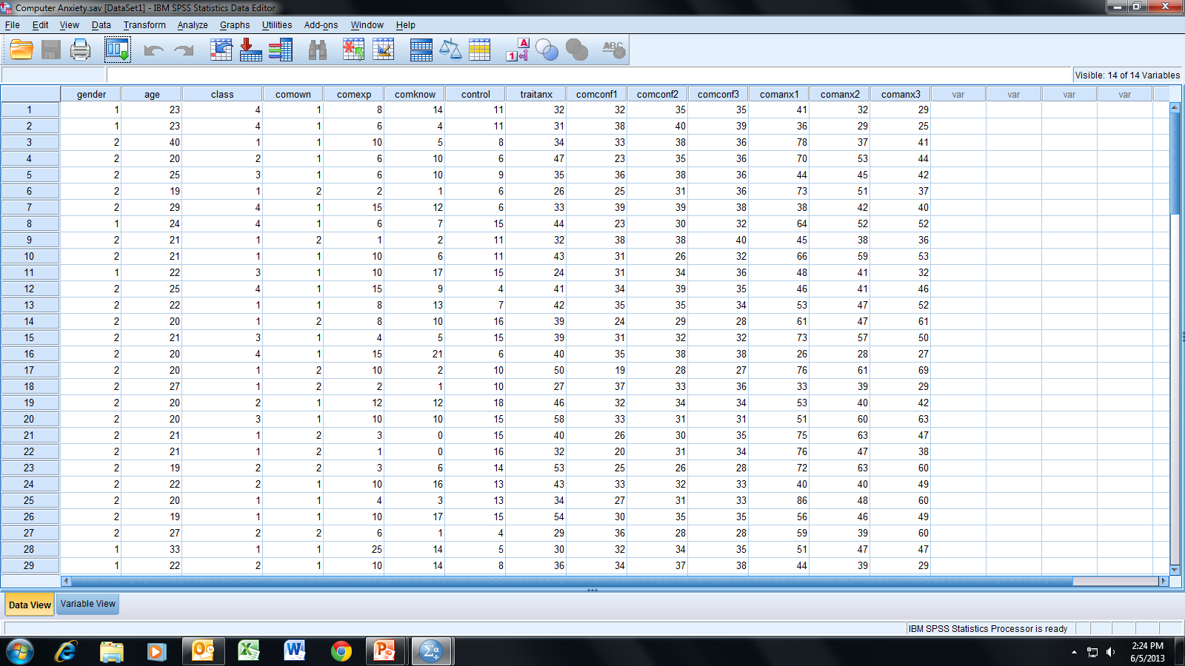
Open the dataset Computer Anxiety.sav.
File available at http://www.watertreepress.com/stats

Slide 4
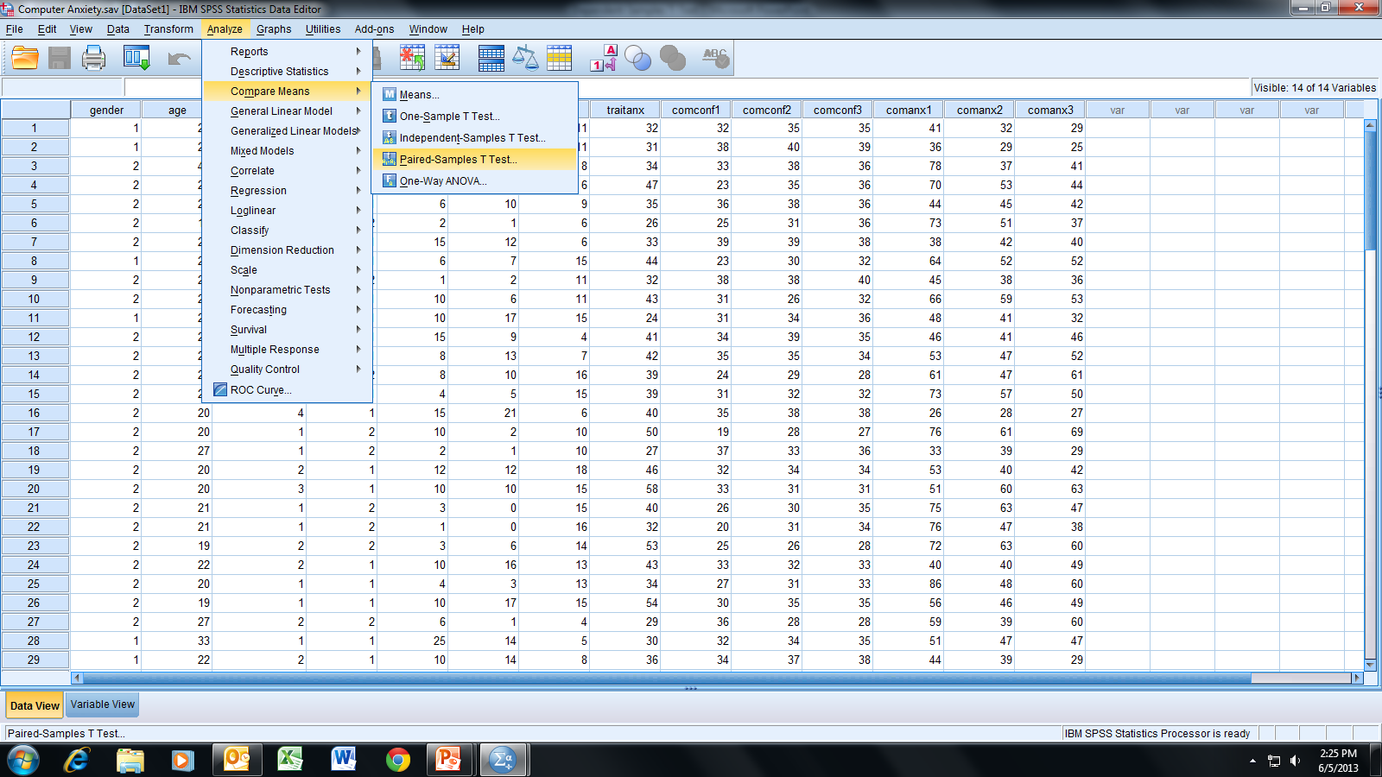
Follow the menu as indicated.

Slide 5
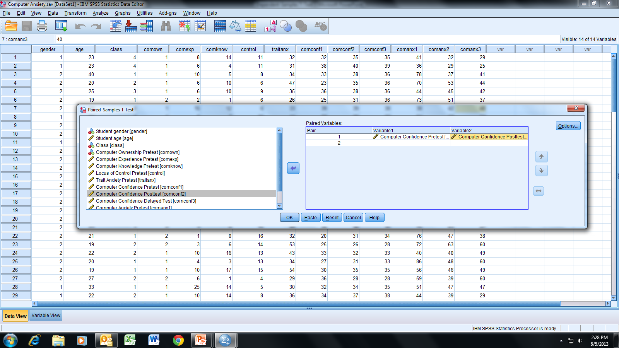
In this example, we will test the following null hypothesis:
H_{o}: There is no difference in computer confidence pretest
and posttest among university students (i.e., μ₁ = μ₂).
Select and move Computer Confidence Pretest [comconf1] to
Variable 1 and Computer Confidence Posttest [comconf2]
to Variable 2 in the Paired Variables box; click OK.

Slide 6
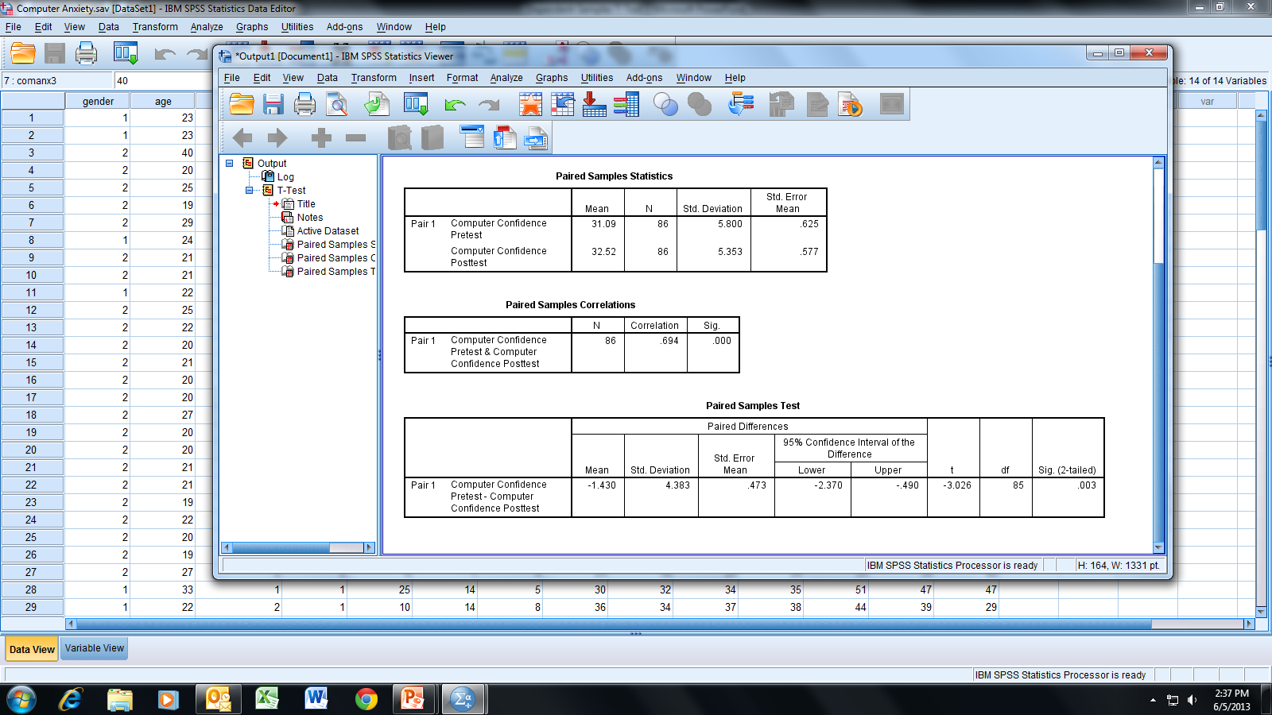
For the dependent-samples t-test we are testing the null hypothesis
H_{o}: μ₁ = μ₂ in which the subscripts 1 and 2 correspond to the pretest and
posttest, respectively (i.e., the null hypothesis is that the mean is the
same for both the pretested and posttested populations).
We will choose α = .05 for a two-tailed test (i.e., we are interested if either
mean is larger than the other). Note that the significance value of
.003 < α; therefore, we reject H_{o} and conclude that there is a statistically
significant difference between the pretest and posttest population means.

Slide 7
CI₉₅ of the difference is (-2.37, -.49). This indicates that we are
95% confident that the difference in the population means is
in the range -2.37 to -.49.
Note that the difference is calculated by variable 1 - variable 2
as defined in the “Paired Variables” box (see slide 5); that is, we
are 95% confident that -2.37 <= μ₁ - μ₂ <= -.49 (i.e., posttest >
pretest by .49 to 2.37).

Slide 8
End of Presentation

